Slide 1
Rerouting the MAPS to UPS:
Targeting a new protein secretion pathway involved in neurodegenerative diseases
Kira Mills

Slide 2
Presentation Outline
Background and Motivation
Neurodegenerative Diseases and Protein Quality Control
UPS and MAPS Mechanisms
Specific Aims
Experimental Plan
Expected Outcomes and Conclusions

Slide 3
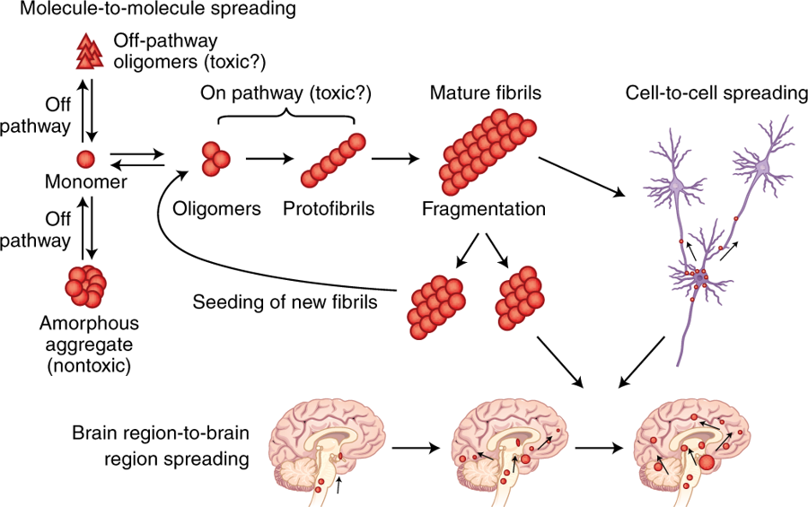
What causes Alzheimer’s and Parkinson’s Disease?
Soto, C.; Pritzkow, S. Protein Misfolding, Aggregation, and Conformational Strains in Neurodegenerative Diseases. Nat. Neurosci. 2018, 21 (10), 1332–1340.

Slide 4
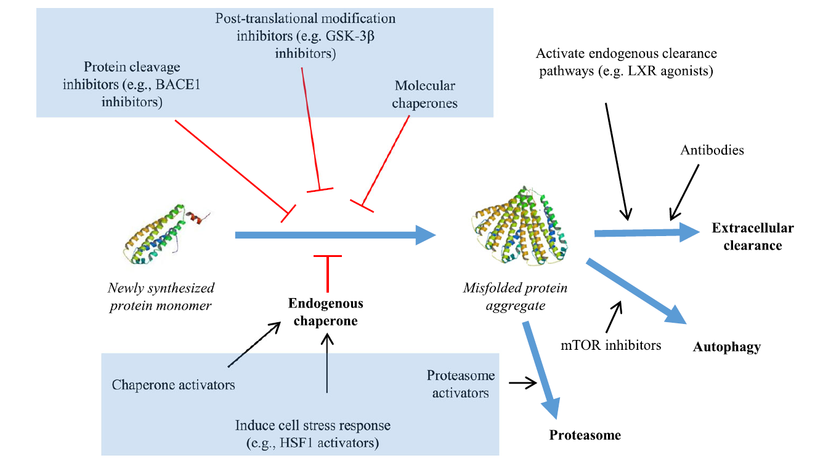
How do cells usually prevent this?
Healthy cells have a PQC network of multiple pathways and mechanisms to prevent misfolding or to detect/remove misfolded proteins
Sweeney, P.; Park, H.; Baumann, M.; Dunlop, J.; Frydman, J.; Kopito, R.; McCampbell, A.; Leblanc, G.; Venkateswaran, A.; Nurmi, A.; et al. Protein Misfolding in Neurodegenerative Diseases: Implications and Strategies. Transl. Neurodegener. 2017, 6.

Slide 5
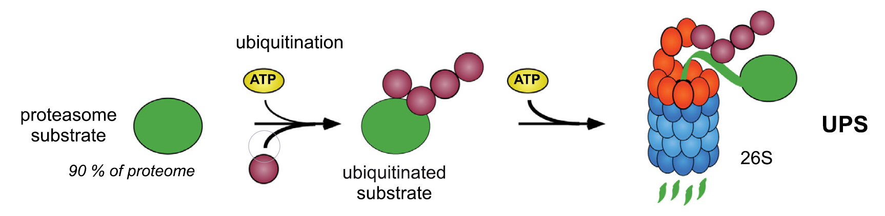
How do cells usually prevent this?
The ubiquitin-proteasome system (UPS) is one of the most efficient pathways for removing misfolded proteins
Opoku-Nsiah, K. A.; Gestwicki, J. E. Aim for the Core: Suitability of the Ubiquitin-Independent 20S Proteasome as a Drug Target in Neurodegeneration. Translational Research. 2018, 198, 48-57

Slide 6
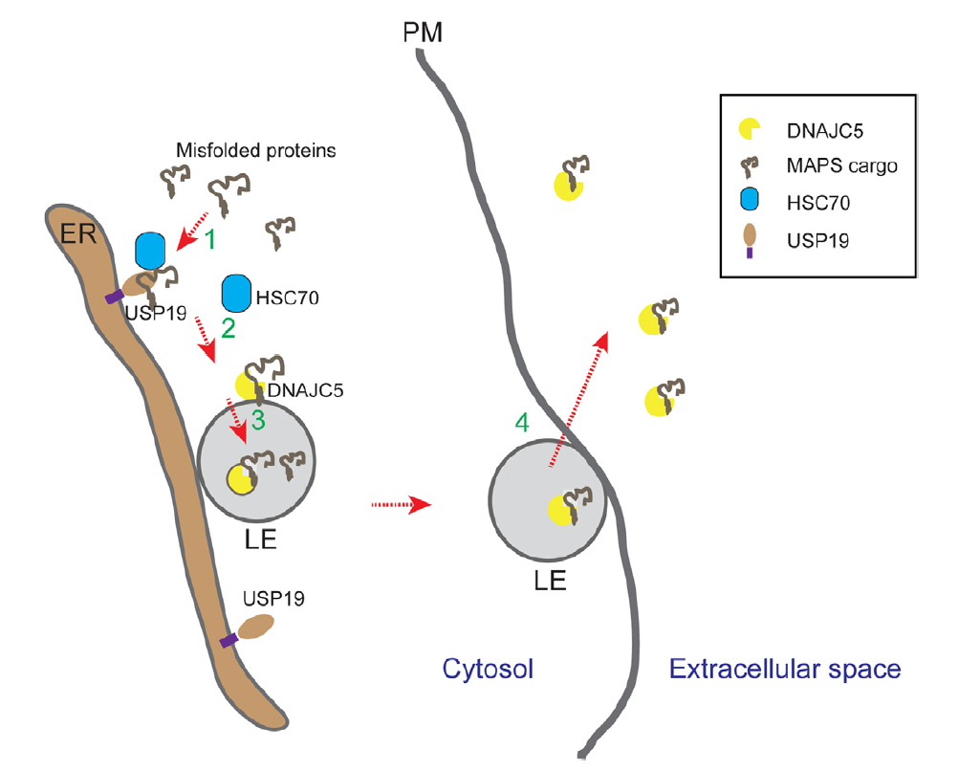
The MAPS Pathway
The misfolding-associated protein secretion pathway was discovered in 2016 and it was further characterized in March 2018
Ye, Y. Regulation of Protein Homeostasis by Unconventional Protein Secretion in Mammalian Cells. Seminars in Cell and Developmental Biology. 2018.

Slide 7
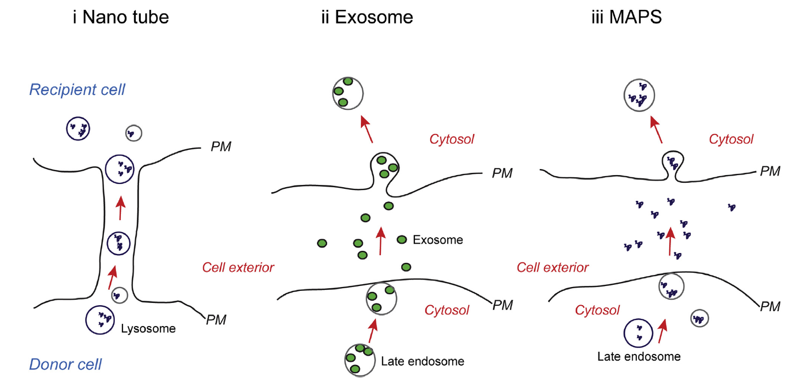
The issue with MAPS
Exports only 5-10% of the substrate it’s exposed to
Could majorly contribute to spread of misfolded proteins
Ye, Y. Regulation of Protein Homeostasis by Unconventional Protein Secretion in Mammalian Cells. Seminars in Cell and Developmental Biology. 2018.

Slide 8

The Plan
To design a small molecule inhibitor of MAPS by mimicking the side chains of Hsc70 at the interaction site with it and DnaJC5
Choosing to target DnaJC5 because it seems to only be involved in protein secretion, whereas the other proteins involved have several other important functions in the cell

Slide 9
Specific Aims
Visualize the interaction site between Hsc70 and DnaJC5
Create a small molecule library to run through docking software to find inhibitors of MAPS
Synthesize most promising molecules and test efficacy as inhibitors

Slide 10
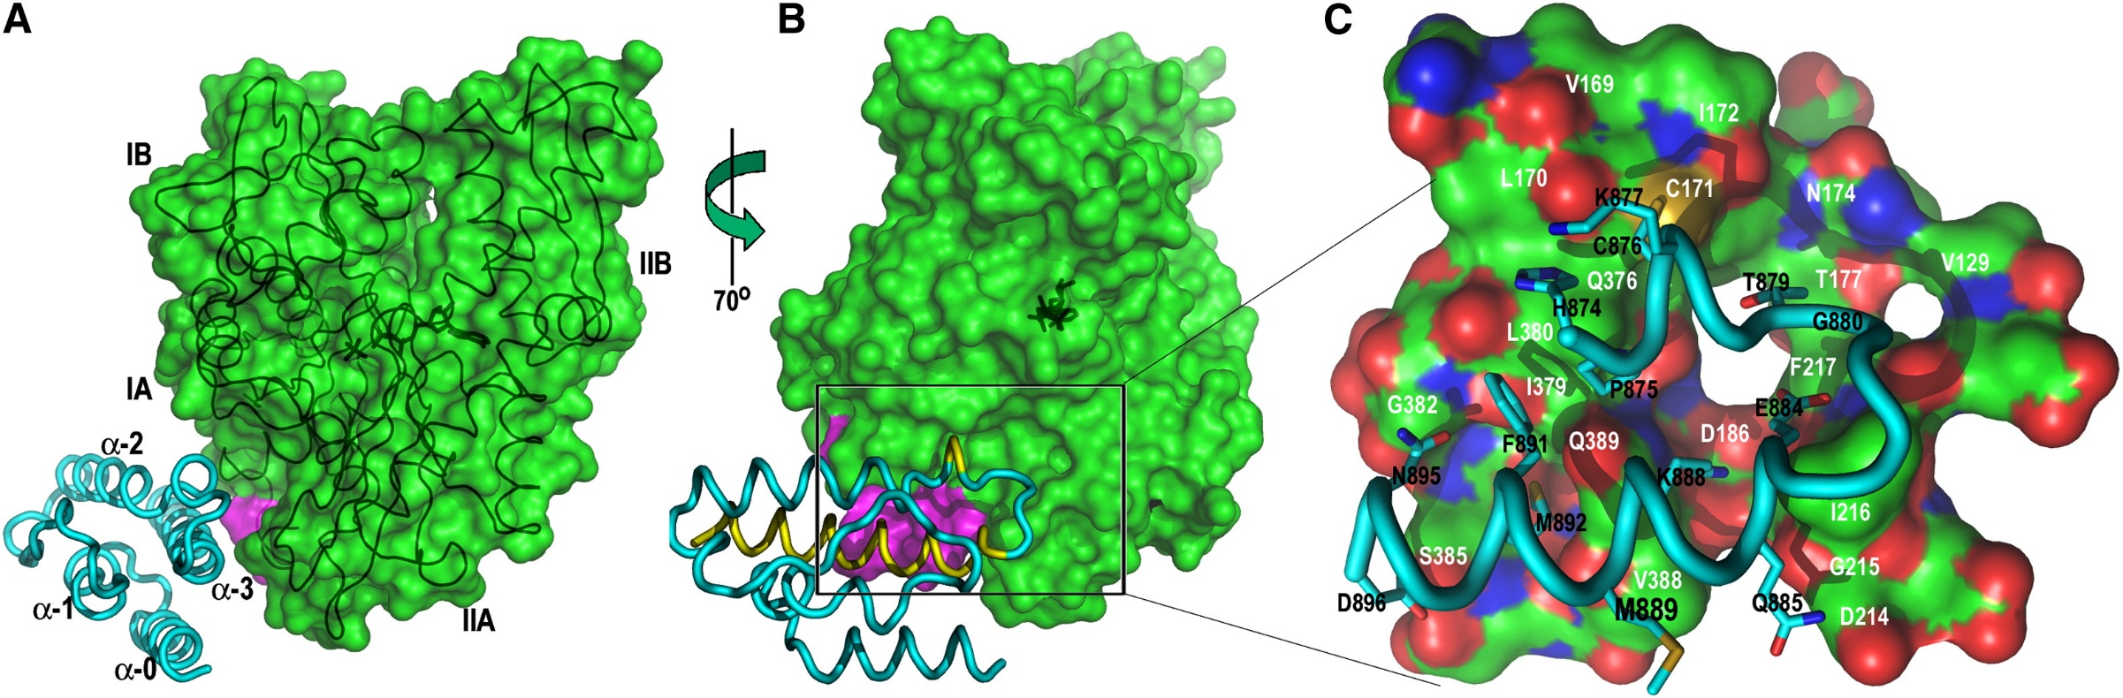
Visualizing the Interaction Site
The interaction site of homologues of Hsc70 and DnaJC5 have previously been visualized and the domains involved have been determined experimentally
Jiang, J.; Maes, E. G.; Taylor, A. B.; Wang, L.; Hinck, A. P.; Lafer, E. M.; Sousa, R. Structural Basis of J Cochaperone Binding and Regulation of Hsp70. Mol. Cell 2007, 28 (3), 422–433.

Slide 11
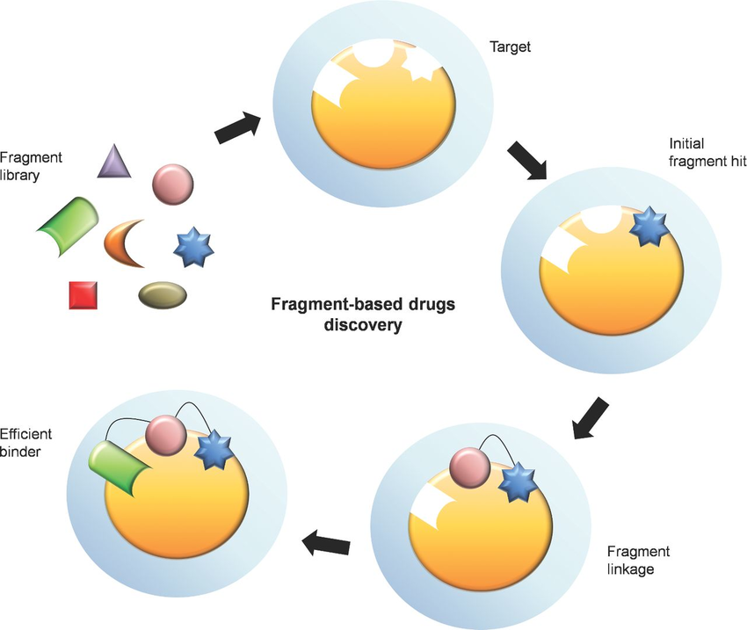
Designing a Small Molecule Library
Using a fragment-based approach to designing the small molecule library
The Hsc70 side chains necessary in the interaction site with DnaJC5 will serve as the initial fragments for the library
The most promising leads will then be synthesized and tested for affinity and inhibitory ability
Chan, W. T.; Balsa, D.; Espinosa, M. One Cannot Rule Them All: Are Bacterial Toxins-Antitoxins Druggable?. FEMS Microbiology Reviews. 2015. 39(4). 522-540.

Slide 12
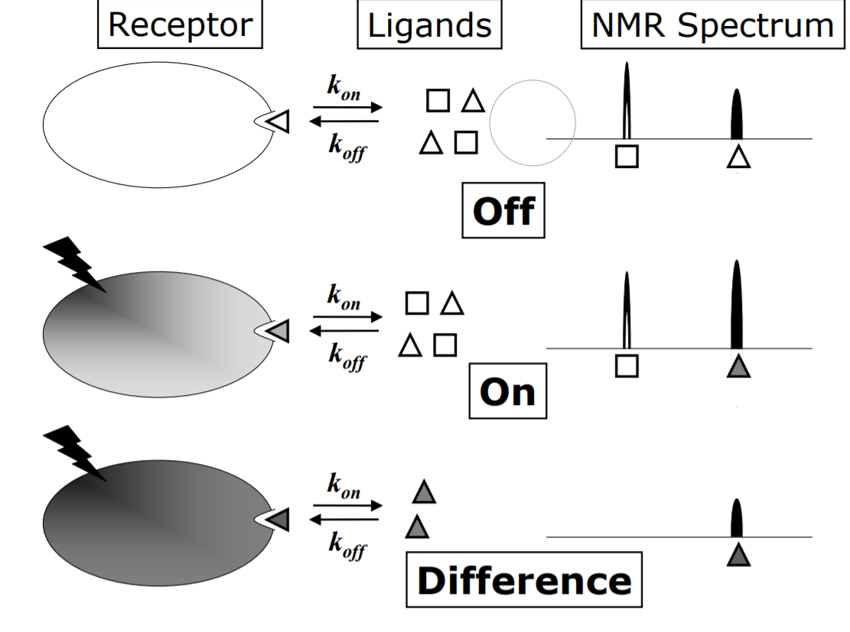
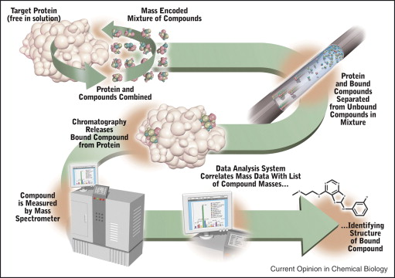
Testing the Lead Compounds
To test binding affinity, we will use a combination of saturation transfer difference NMR and affinity selection mass spec
Krishnan, V. Ligand Screening by Saturation-Transfer Difference (STD) NMR Spectroscopy. Curr. Anal. Chem. 2005, 1 (3), 307–320.
Annis, D. A.; Nickbarg, E.; Yang, X.; Ziebell, M. R.; Whitehurst, C. E. Affinity Selection-Mass Spectrometry Screening Techniques for Small Molecule Drug Discovery. Curr. Opin. Chem. Biol. 2007, 11 (5), 518–526.

Slide 13
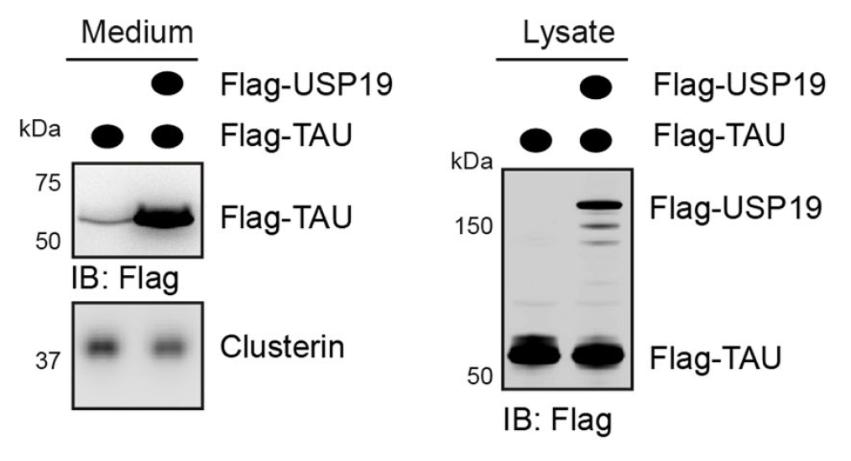
Testing the Lead Compounds
To test the inhibition of MAPS by the small molecules, we will follow the assay protocols developed in a previous study characterizing the pathway, involving simple immunoblotting
Xu, Y.; Cui, L.; Dibello, A.; Wang, L.; Lee, J.; Saidi, L.; Lee, J. G.; Ye, Y. DNAJC5 Facilitates USP19-Dependent Unconventional Secretion of Misfolded Cytosolic Proteins. Cell Discov. 2018.

Slide 14


What’s Next?
Any promising leads will likely have to undergo further optimization to obtain the best inhibitor of MAPS
Ideally, a compound will show enough promise to be further developed as a possible drug, likely in conjunction with a UPS promoter

Slide 15


What if there is no promising lead?
If there are no promising leads, a more diverse library can be run through the docking software
If developing a drug doesn’t seem possible, this project will still have helped better understand a newly discovered cellular pathway

Slide 16
References
Wolff, S.; Weissman, J. S.; Dillin, A. Differential Scales of Protein Quality Control. Cell. 2014, 157, 52-64.
(2) Kim, Y. E.; Hipp, M. S.; Bracher, A.; Hayer-Hartl, M.; Hartl, F. U. Molecular Chaperone Functions in Protein Folding and Proteostasis. Annu. Rev. Biochem. 2013, 82, 323-55.
(3) Sweeney, P.; Park, H.; Baumann, M.; Dunlop, J.; Frydman, J.; Kopito, R.; McCampbell, A.; Leblanc, G.; Venkateswaran, A.; Nurmi, A.; et al. Protein Misfolding in Neurodegenerative Diseases: Implications and Strategies. Transl. Neurodegener. 2017, 6.
(4) Xu, Y.; Cui, L.; Dibello, A.; Wang, L.; Lee, J.; Saidi, L.; Lee, J. G.; Ye, Y. DNAJC5 Facilitates USP19-Dependent Unconventional Secretion of Misfolded Cytosolic Proteins. Cell Discov. 2018, 4.
(5) Frost, B.; Diamond, M. I. Prion-like Mechanisms in Neurodegenerative Diseases. Nat. Rev. Neurosci. 2010, 11(3), 155–159.
(6) Brundin, P.; Melki, R.; Kopito, R. Prion-like Transmission of Protein Aggregates in Neurodegenerative Diseases. Nat. Rev. Mol. Cell. Biol. 2010, 11(4), 301–307.
(7) Ye, Y. Regulation of Protein Homeostasis by Unconventional Protein Secretion in Mammalian Cells. Semin. Cell. Dev. Biol. 2018.

Slide 17
References
(8) Fontaine, S. N.; Zheng, D.; Sabbagh, J. J.; Martin, M. D.; Chaput, D.; Darling, A.; Trotter, J. H.; Stothert, A. R.; Nordhues, B. A.; Lussier, A.; et al. DnaJ/Hsc70 Chaperone Complexes Control the Extracellular Release of Neurodegenerative‐associated Proteins. EMBO J. 2016, 35, 1537–1549.
(9) Hansen, C.; Angot, E.; Bergström, A. L.; Steiner, J. A.; Pieri, L.; Paul, G.; Outeiro, T. F.; Melki, R.; Kallunki, P.; Fog, K.; et al. α-Synuclein Propagates from Mouse Brain to Grafted Dopaminergic Neurons and Seeds Aggregation in Cultured Human Cells. J. Clin. Invest. 2011, 121, 715-725.
(10) Guo, J. L.; Lee, V. M. Y. Seeding of Normal Tau by Pathological Tau Conformers Drives Pathogenesis of Alzheimer-like Tangles. J. Biol. Chem. 2011, 286, 15317–15331.
(11) Opoku-Nsiah, K. A.; Gestwicki, J. E. Aim for the Core: Suitability of the Ubiquitin-Independent 20S Proteasome as a Drug Target in Neurodegeneration. Translational Research. 2018, 198, 48-56.
(12) Bercovich, B.; Stancovski, I.; Mayer, A.; Blumenfeld, N.; Laszlo, A.; Schwartz, A. L.; Ciechanover, A. Ubiquitin-Dependent Degradation of Certain Protein Substrates in Vitro Requires the Molecular Chaperone Hsc70. J. Biol. Chem. 1997, 272, 9002-9010.
(13) Hennessy, F.; Cheetham, M. E.; Dirr, H. W.; Blatch, G. L. Analysis of the Levels of Conservation of the J Domain among the Various Types of DnaJ-like Proteins. Cell Stress Chaperones 2000, 5(4), 347–358.

Slide 18
Thank You
Questions?

